Slide 1

Dynamic Data Loading in Azure
Aakash Sukre

Slide 2
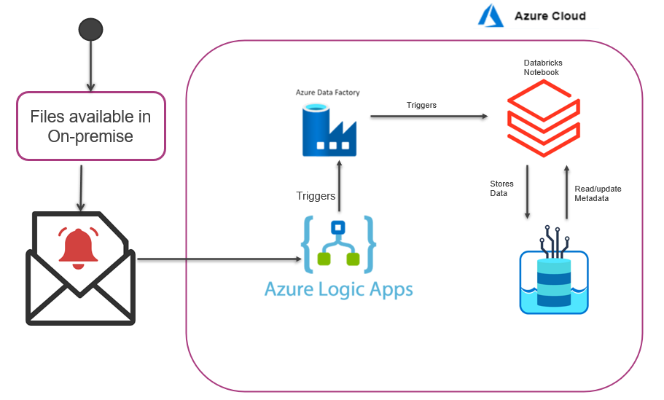
Dynamic Data Loading through config tables in Azure
Existing solutions: Existing approaches for data ingestion loads the data once they arrive at landing area and separate pipelines are required to process different types of file sources.
Proposed Solution: Proposed solution is to automate the data loading and movement of files from the on-premise to cloud and to dynamically ingest the files based on the type of file.
Case
Solution
Automation of Data Extraction
Dynamic ETL ingestion
Dynamic pickup of files based on configurations.
Load Files through attachment or pick from on premise.
Metadata driven approach to pickup and load data.
Dynamic Loading of data based on any type of data.
Incremental loading of data dynamically.
Challenges
Auto pickup of files from on premise servers.
Load files from Email attachment.
Creation of Metadata storage for implementing dynamic data loading.
Serverless programming(Logic Apps) to manage flow of data loads.
Implementation of mechanism to pick up file based on any type of data.
Data
For POC, it will demonstrated using personal machine as data source and sample type of different data such as csv, txt & Parquets.

Slide 3


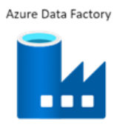

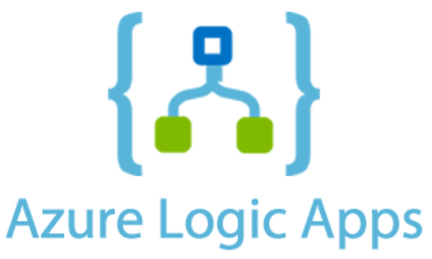

Azure Services Load Diagram
Databricks Notebook
Files available in On-premise
Triggers
Stores Data
Read/update Metadata
Triggers

Slide 4
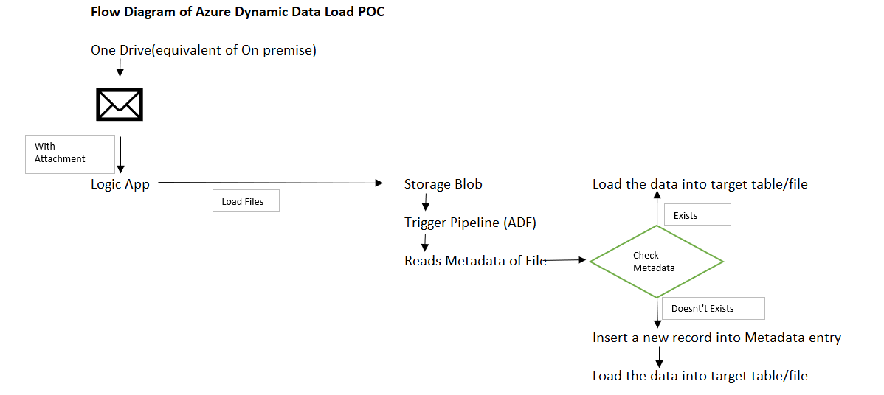
Flow Diagram

Slide 5
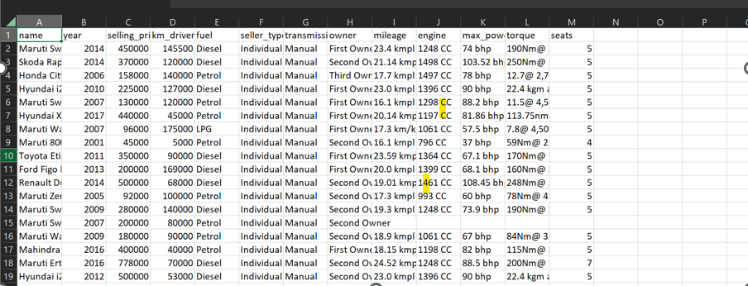
Sample Dataset
This dataset contains information about used cars listed on different websites
This data can be used for a lot of purposes such as price prediction
The columns in the given dataset are as follows:
name
year
selling_price
km_driven
fuel
seller_type
transmission
Owner
Different types of files to be used as source input such as CSV, TXT, Excel etc having different columns.
Vehicle Dataset:

Slide 6
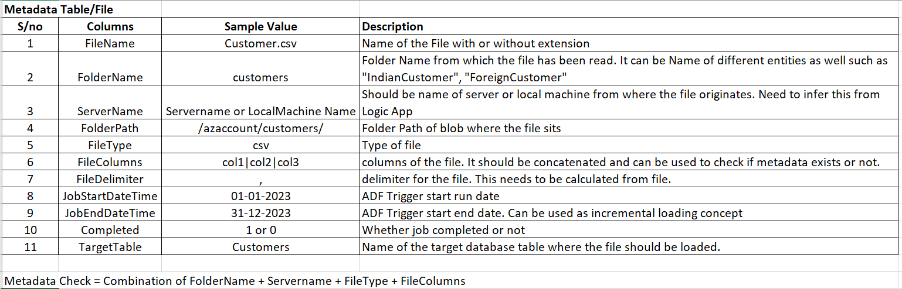
Metadata Table/File

Slide 7
Set of Activities to be accomplished
Triggering Email to activate the Logic App call.
Logic App Logic to check if email has attachment. If email has an attachment, it should load the attachment into DataLake.
Calling Azure Data Factory(ADF) through Logic App. Trigger Databricks Notebook through ADF.
Implementation of metadata tables in the database.
ADF logic to pick up files from on-premise server based on metadata table.
Logic to identify the file type in ADF. Logic to vary based on file type. *Dynamic load*
Logic to identify the file columns and store in database tables through ADF.

Slide 8
Cost and Efforts Estimation
Azure Service​ | Estimated Cost (USD)​ based on 100 hours
Blob Storage​ | $2.00​
logic App | $8.00​
Data Factory | $18.00
SQL database | $14.00​
Power BI Desktop​ | $0.00​
Total Estimated Cost​ | $42.00​
Phases​ | Days​
Environment Setup​ and Data Prep | 2
Development , Data ingestion &Transformation​ | 7
Report​ | 2​
Testing | 1
Total Effort estimation​ | 12 days​

Slide 9
Thanks

